Slide 1
Chapter 5 continued
Impedance systems, Amplifying, Filtering, & Digitizing signals

Slide 2
Advantages & Disadvantages of High Impedance Systems
Advantages
Reduce the amount of time required to prepare each subject
Reduce the likelihood of disease transmission
More pleasant for subjects
Disadvantages
Poor common mode rejections
May increase skin potential artifacts
More low frequency noise than low impedance systems.
Notes:
High-Impedance의 장점은 실험 set up 하는데 시간을 절약할 수 있고 (두피의 top layer를 안 긁어도 되기 때문에), 질병 전파 가능성을 줄일 수 있고, 1번이랑 비슷한 이유로 참여자에게 더 pleasant 할 수 있다.
단점은 common mode rejections 과 skin potential artifacts 로 인하여 low impedance 기계보다 noise가 더 발생한 다는 점이다. 하지만, Luck은 impedance 등 다른 factor들이 다 동일하면 high-impedance 기계가 더 나을 수가 있다고 말한다. 더불어, high impedance 기계는 두피를 안 긁어내도 되기 때문에 유아 또는 어린이 대상 실험으로 더 적합할 수 있다. High impedance 기계를 쓴다면 여러가지 방법으로 imdedance를 낮출 수 있다. Washing hair, combing hair, cool environment, 조금 더 신경 쓴다면 low impedance 처럼 abrading 할 수 있다.

Slide 3
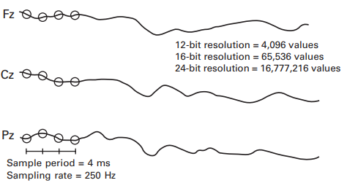
Amplifying, Filtering, and Digitizing the Signal
Digitizing the EEG
Converting the analog signal to a set of discrete samples
Done through a device called an analog-to-digital converter (ADC)
Amplification before Digitization
Necessary to bring the EEG voltage into the appropriate range for the ADC
Notes:
옛날 기기들은 12 bit 를 사용했지만 최근에는 16-32 bit 기기를 사용한다. Which provides greater resolution and broader range of values. Amplification provides much smaller steps between values.
the sampling period is the amount of time between consecutive samples (e.g., 4 ms), and the sampling rate is the number of samples taken per second (e.g., 250 Hz).

Slide 4
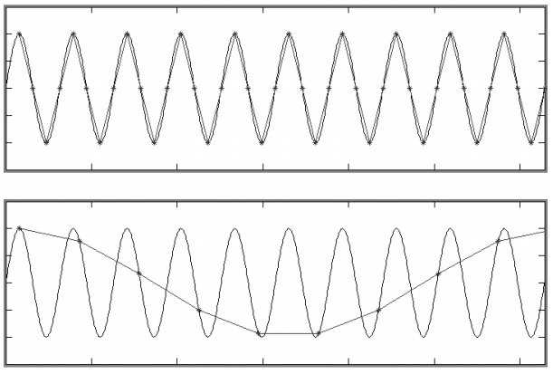
Discrete Time Sampling and Low-pass filters
Sampling rate is important to collect accurate data.
Nyquist theorem
Aliasing – induce artifactual low frequencies in the digitized data.
Notes:
all of the information in an analog signal can be capture digitally as long as the sampling rate is more than twice as great as the highest frequency in the signal. So If you are interested in ERPs that mainly contains power below 30Hz. You record at any rate higher than 60 Hz. But ERPs will naturally contain frequencies higher than 30 Hz. So you set a cut off frequency which eliminate all activity above a certain frequency.

Slide 5
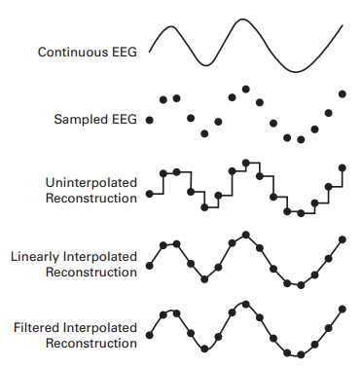
Notes:
Sampling with the right interpolation method can reconstruct the original signal (pretty much perfectly)

Slide 6
Amplifier Gain and Calibration
In most modern systems, the electrodes are attached to a small box that contains both amplifier and the ADC.
Some are customizable, some are not. (gain and filter settings)
Luck’s lab uses non-customizable system.
In all systems, the signal is amplified and calibration must be done in order to make sure there is no effect on the data.
Pass a known voltage through the system and measure the system’s output.
Notes:
if you create a series of 10- μ V voltage pulses and run them into your recording system, it may tell you that you have a signal of 9.8 μ V on one channel and 10.1 μ V on another channel.
it is unlikely to change your conclusions if the average N400 amplitude in a given experiment appeared to be 4.2 μ V even though the true value was 4.0 μ V. However, if the gain varies from subject to subject, this will add variance to your data and decrease your statistical power

